Slide 1


FA25 - ENGR - E583
INFORMATION VISUALIZATION
Final Project Presentation
Understanding the dynamics of the Emerging Community of Structural Biologists in Africa
Presentation By
Sushil Amalan John Moses
(sujohnmo@iu.edu)
Pravin Raj Senguttuvan
(prasengu@iu.edu)
Mohammad Fahad Shahul Hameed (moshahul@iu.edu)
Vimal Aditya Raj
(varadh@iu.edu)
Athish Gopal Rajesh
(agr@iu.edu)

Slide 2






Team Members
Pravin Raj Senguttuvan
MS DS Student, IUB
Athish Gopal Rajesh
MS DS Student, IUB
Mohammed Fahad Shahul Hameed
MS DS Student, IUB
(Project Leader)
Vimal Aditya Raj Varadharaj
MS CS Student, IUB
Sushil Amalan John Moses
MS DS Student, IUB

Slide 3
Introduction
BioStruct-Africa is a pan-African initiative focused on building capacity in structural biology through training workshops, mentorship, and research collaboration.
Our project analyzes 308 anonymized workshop applications (Kenya, Cameroon, Mali) to understand regional participation, institutional representation, and discipline diversity.
Motivation
Raw data included inconsistent institution names, missing regions, and unstructured disciplines, limiting actionable insights.
Stakeholders need clear, standardized, and privacy-preserving analytics to guide future workshop planning.
Visual analytics (Geospatial, Sankey) can reveal hidden patterns in mobility, regional reach, and training gaps across Africa.
Stakeholder Needs
BioStruct-Africa Leadership: Identify regional gaps, participation trends, and emerging scientific hubs.
TILLER ALPHA (Client): Scalable, reproducible visual analytics; GDPR-compliant reporting.
Mentors & Trainers: Understand discipline mix, career-stage distribution, and institutional engagement.
Participants & Early-Career Scientists: Visibility into community growth and collaboration opportunities.
Introduction, Motivation and Stakeholder Needs

Slide 4
Total Records: 308 participants
Time Period: 2019,2022,2024
Geographic Coverage: ~20 African countries
Key Attributes:
Anonymized participant IDs
Country of affiliation
Institutional category
Highest academic degree
Scientific discipline
Year of application and participation
Data Quality: High consistency, minimal
missing entries
Privacy Measures: GDPR-compliant
Dataset and Statistics
Dataset has been provided by our client, we cleaned it and fuzzy matched it. We also used external data sources as such as “continents”, “world-universities” as an effort to match lean and enrich.
Career stages:
Pre-Doc (145)
PhD (77)
PostDoc (46)
Senior Scientist (32)
Top contributing countries: Nigeria, Cameroon, Mali, Kenya, Ghana, Sudan, Egypt, Uganda
Gender Ratio: 201 male (65.3%), 107 female (34.7%)

Slide 5
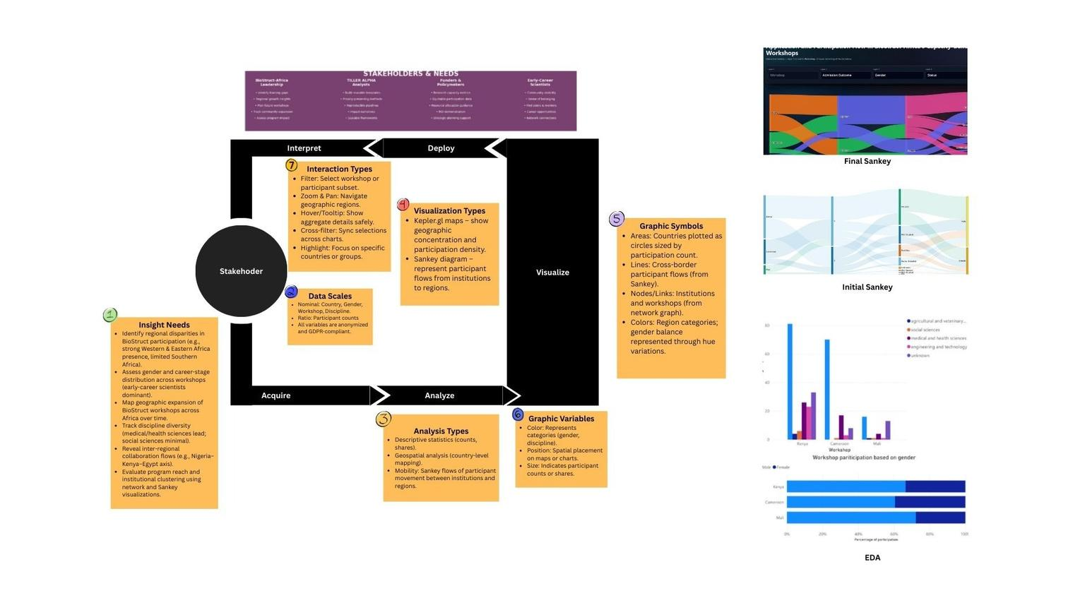
DVL Framework
Insight Needs:
Identify participant origins, regional gaps, discipline mix, gender balance, institutional flows, and future workshop targeting.
Data Scales:
Nominal (country, region, gender, workshop), geospatial (lat/long), derived (fuzzy-matched institutions, OECD disciplines).
Analysis Types:
geospatial mapping , Sankey flow analysis.
Visualization Types:
Kepler maps, Sankey flows.
Graphic Symbols/Variables:
Color, size, geographic position.
Interaction Types: Filter, hover, cross-filter
Deployment:
Interactive HTML visuals, enriched dataset, client-focused report and slides.
Interpretation:
Understand regional reach, diversity, discipline profiles, and inform future BioStruct workshop strategy.

Slide 6
Standardization and Data Pre Processing
1. Data Pre-Processing
Removed unused or empty fields (e.g., Institutional_ID).
Normalized strings (lowercasing, trimming, punctuation removal).
Deduplicated institution entries and harmonized spelling variants.
2. Fuzzy Matching
Institutions appear in many inconsistent forms.
Exact matching fails for misspellings & abbreviations.
Fuzzy matching helps choose the closest valid institution from reference lists.
3. Region / Continent Mapping
Replaced generic “Africa” with specific subregions using:
UNSD regional schema
Ensured consistent country–region mapping for geospatial (Kepler) layers.
How We Did It:
Multi-stage fuzzy pipeline (token-sort, token-set, partial-ratio).
Cross-checked with:
ROR research institution registry
Fixed mismatches (e.g., "Lagos State Univ" → "Lagos State University").
4. Discipline Standardization
Scientific disciplines were free-text (e.g., “biochem”, “drug bio”).
Mapped them to standardized major categories using:
OECD → Web of Science (2022) mapping table.
Enabled aggregated Sankey flows & discipline-level insights.

Slide 7
Upgrades from previous Iteration
Added persistent, scrollable tooltips to improve readability and allow users to explore detailed metrics without losing hover focus.
Implemented click-to-highlight flow paths so users can easily trace complete journeys across the Sankey diagram.
Refined node spacing, color contrast, and white text labels to enhance legibility and reduce clutter across all Sankey layers.
Corrected and standardized career-stage categories, workshop names, and discipline labels for a cleaner, more consistent dataset.
Rebuilt the Kepler visualization using updated country coordinates and workshop mappings, resulting in a clearer and more accurate geographic flow map.
Improved overall interaction smoothness and layout responsiveness across both visualizations for a better user experience.

Slide 8
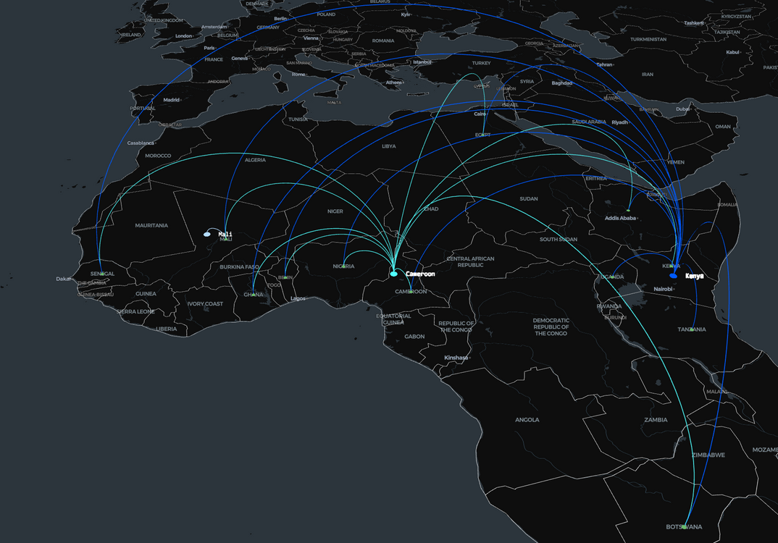
Geospatial Visualization (Kepler.gl)
The map displays the geographic origins of workshop applicants, with arcs connecting each country to the workshop they applied to or attended.
Arc frequency reflects participation volume—countries with stronger engagement show more prominent flows.
Distinct colors differentiate the three workshops (Mali, Cameroon, Kenya), helping viewers compare regional reach across years.
The visualization highlights major contributor countries such as Nigeria, Benin, Botswana, and Ghana, showing clear cross-regional mobility.
By placing all flows on the African map, the figure reveals BioStruct-Africa’s expanding geographic footprint and the diversity of applicants engaging with each workshop.

Slide 9
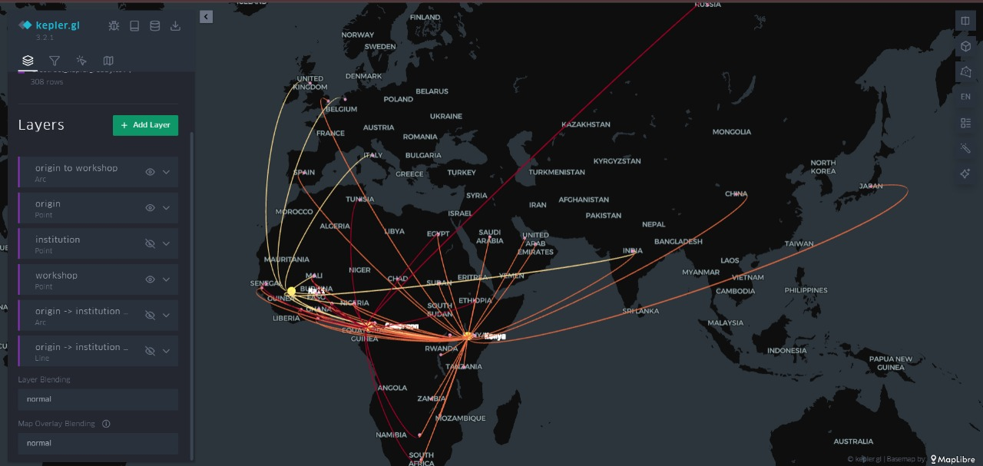
Upgrades from previous Iteration
Geospatial Visualization Before
Geospatial Visualization After

Slide 10
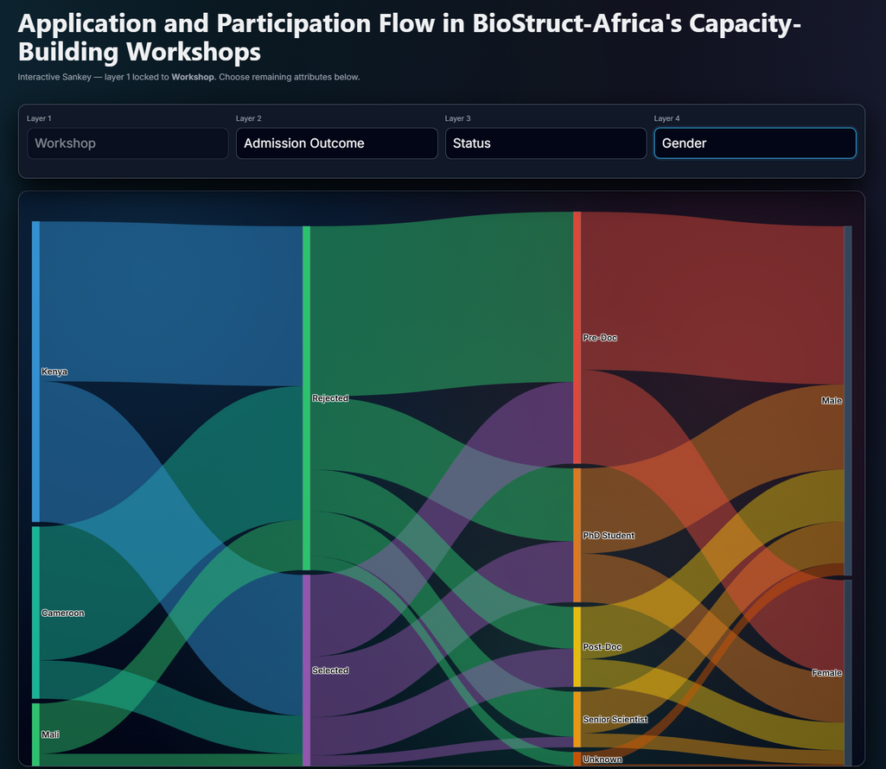
Flow visualization (Sankey)
The Sankey diagram visualizes applicant flow across multiple attributes—Workshop → Admission Outcome → Gender → Career Stage—with each stage represented as an interactive column.
Users can click on any dropdown to reorder, change, or explore different categorical pathways such as Field of Research or Status.
Hovering over any flow displays detailed metrics through enhanced persistent tooltips, allowing users to inspect counts without losing visibility.
Clicking a specific flow highlights its entire path, making it easier to trace how a group of applicants moves across categories.
Node spacing, white text labels, and filtered options help reduce visual clutter, enabling a clear, intuitive exploration of the applicant pipeline

Slide 11

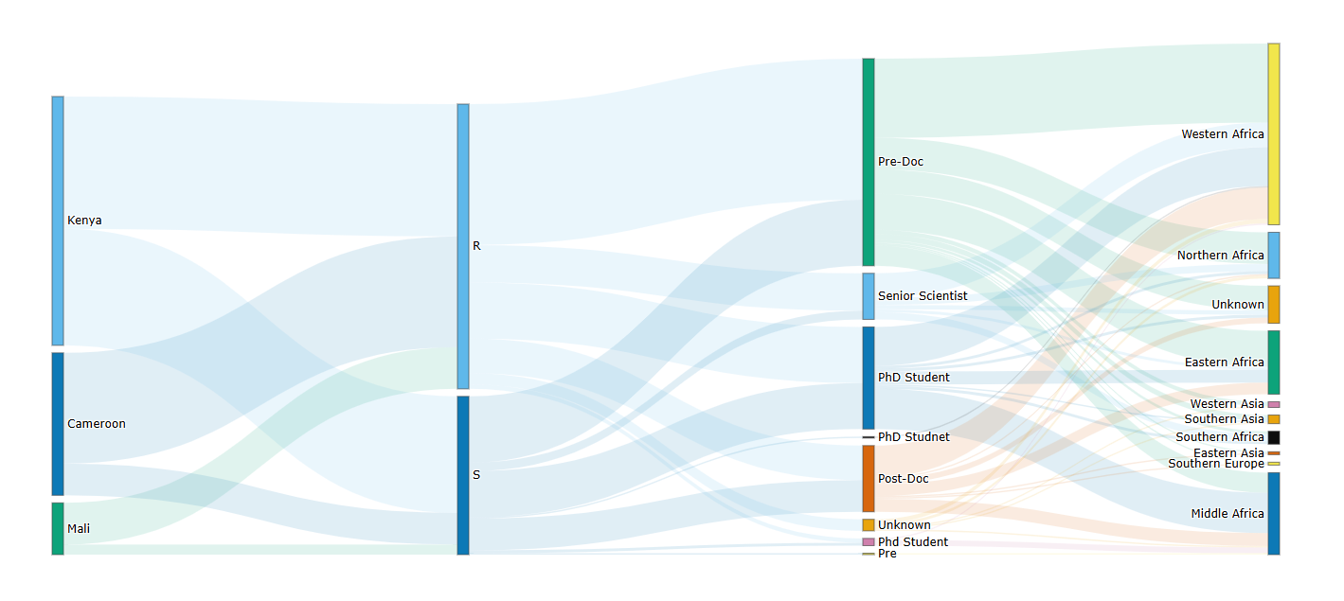
Upgrades from previous Iteration
Sankey Visualization Before
Sankey Visualization After

Slide 12
Actionable Insights - Kepler and Sankey
Kepler
Kenya is the primary regional hub, drawing the most geographically diverse participants and strongest cross-border flows.
Western Africa (Nigeria, Ghana, Cameroon) contributes the largest share of total applicants to all workshop
Sankey
Natural Sciences dominate the applicant pipeline, followed by Medical & Health Sciences, confirming strong scientific orientation across all workshops.
Admission outcomes reflect capacity limits, with a large share of applicants flowing into the “Rejected” category regardless of workshop location.
Gender imbalance is visually clear, as male flows are consistently thicker across all disciplines and workshops.
Early-career researchers (Pre-Docs and PhD students) form the majority, revealing strong demand from emerging scientists.
Disciplinary pathways differ subtly by workshop, indicating Kenya draws more science-heavy profiles, Cameroon more clinical/health, and Mali more agricultural/social sciences.
Sankey highlights multi-step filtering—from workshop → outcome → gender → career stage—making it easier to trace where bottlenecks or imbalances occur in the training pipeline.

Slide 13
Links to our Resources
prasengu/E583-Biostruct: This repository is created for client project discussion and visualization creation for biostruct Africa
https://www.dropbox.com/scl/fi/oxoy46sb8p8bln0aehdsn/kepler_Version_Final.html?rlkey=k13p4ng4o83y7q9jng4brdww1&st=27geb6ni&dl=0
https://biostruct-africa-kdme7xxyo-mohammed-fahads-projects-153ffa8c.vercel.app/

Slide 14
Challenges Faced
Data limitations such as incomplete metadata, inconsistent institution names, and missing precise geolocations required manual cleaning and restricted fine-grained analysis.
Scalability constraints emerged as interactive visualizations grew more dense; larger future datasets may require optimization or pipeline automation.
Longitudinal insights remain limited because workshop-year metadata is not yet fully integrated, preventing time-series comparisons.
Future Work
Future enhancements include automating data standardization, integrating institutional affiliation when GDPR-compliant, and adding filters for country, discipline, and participant subgroups.
Expanded analytics—such as mobility tracking, co-attendance networks, and year-over-year trends—can provide deeper understanding as additional cohorts are added.

Slide 15
THANK YOU!

